Slide 1
Think Global, Act Local
Climate change –
happening here and now

Slide 2
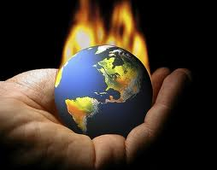
The world is in our hands
What sort of world will we hand over to our children and grandchildren?

Slide 3
Temperature Rise
Climate change is real and happening now
Climate change is now man-made
We have to stop pumping greenhouse gases into the atmosphere now
We must leave coal, oil and gas in the ground

Slide 4
The climate is changing here and now - you change too.

Slide 5
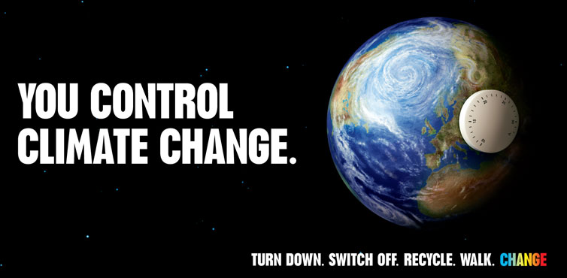

Slide 6
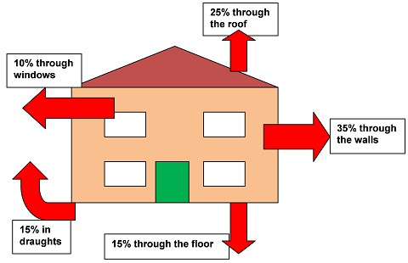
Heat your home, not the atmosphere

Slide 7
Use Renewable Energy and Heat

Slide 8
Grow Your Own Plant a Tree

Slide 9
Enjoy the outdoors, breathe fresh air, and get fit

Slide 10
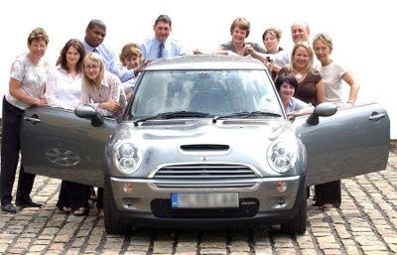
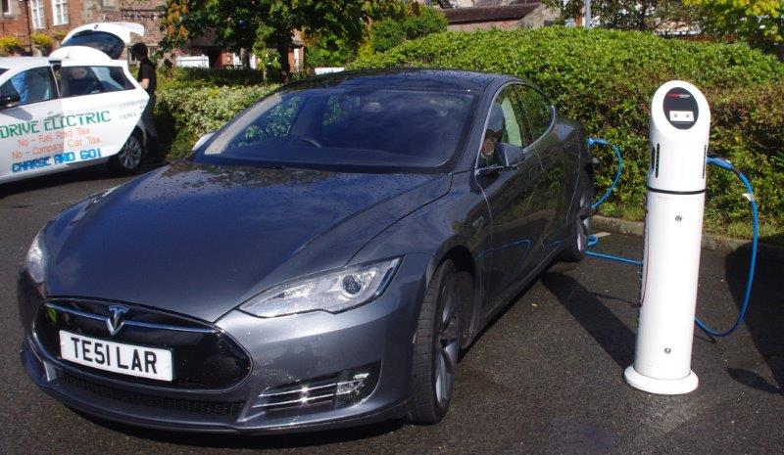
Transport – Time for a shift
Car sharing
Go electric

Slide 11
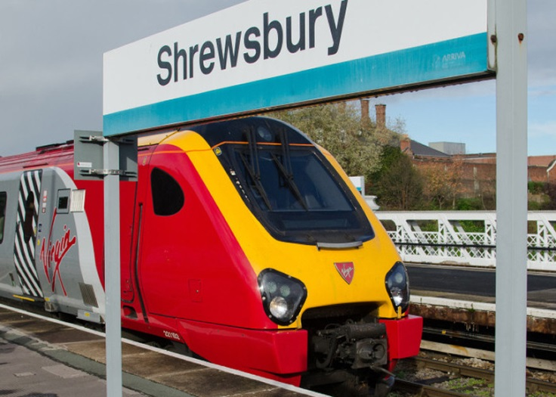
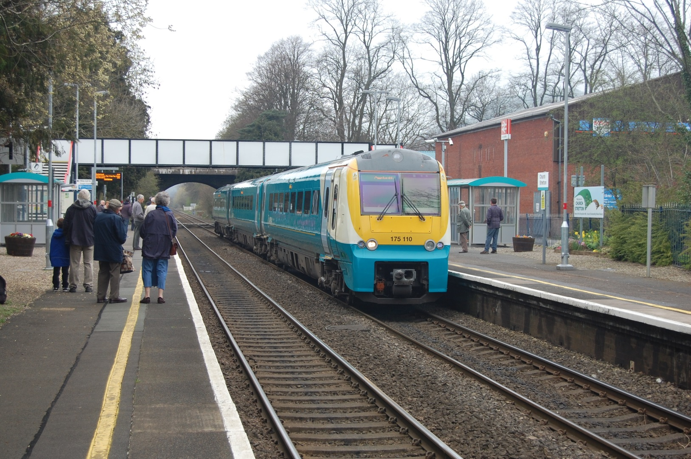
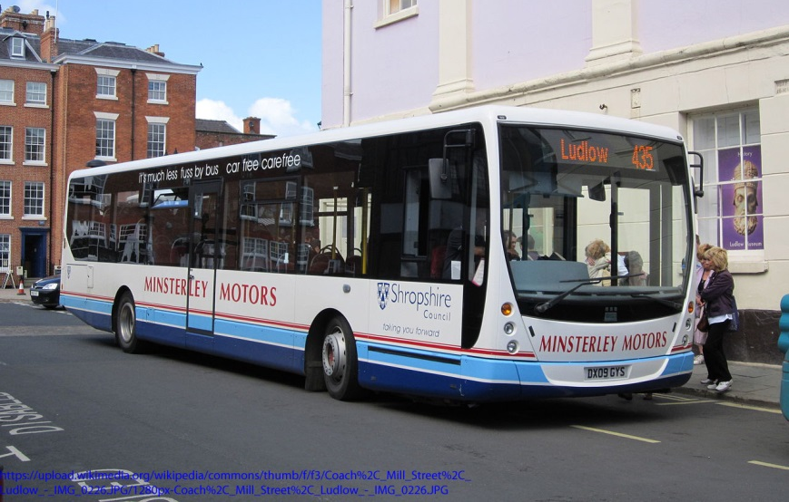
Use public transport – Campaign to keep it

Slide 12
Everyone wins!

Slide 13
Join in, make the change, make a difference

Slide 14
The future is in your hands
Think Global, Act Local

